Slide 1

Library Management System

Slide 2
About Me
Background
B.Tech in Artificial Intelligence and Machine Learning.
Why you want to learn Data Science
Data Science skills like Python, SQL, and Machine Learning can open up diverse roles from analytics to AI. Organizations increasingly rely on data; I want to be part of that transformation.
Share your LinkedIn and GitHub profile URLs
LinkedIn: www.linkedin.com/in/kadali-sushma-sri-a6517a2b1
Github: https://github.com/Sushmasri23

Slide 3
Agenda
Objective of the Project.
ER Diagram and schema explanation.
Key analysis questions.
SQL query results.
Final Business Insights & Recommendations.
Conclusion.
Experience and Challenges.

Slide 4
Objective of the Project
Maintains accurate and structured records of books, borrowers, authors, publishers, and library branches.
Tracks book availability and copies across different branches.
Manages borrowing transactions, including issue date, due date, and return status.
Provides easy retrieval of information for both users and staff.
Improves the efficiency of library operations by minimizing manual work and reducing errors.

Slide 5
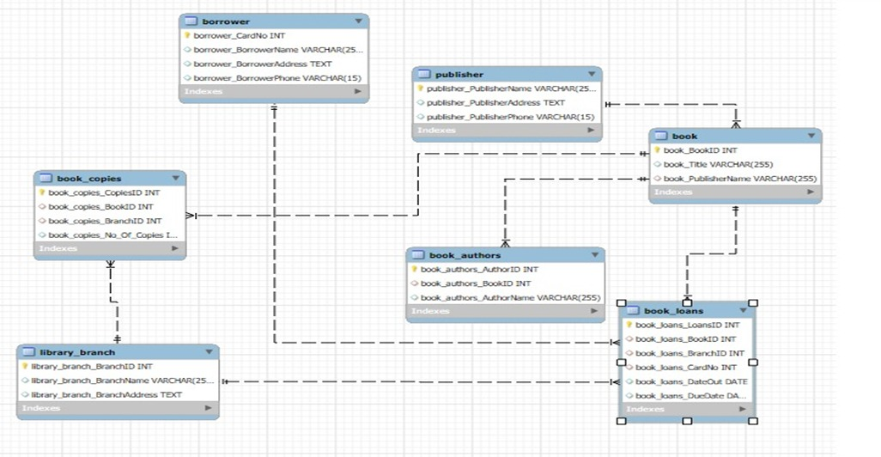
ER Diagram

Slide 6
Schema Explanation
publisher - Stores publisher details. One publisher can publish many books.
book - Stores book details. Linked to publisher, authors, copies, and loans.
book authors - Stores authors of books. One book can have many authors.
library branch - Stores branch details. One branch can have many books and loans.
book copies - Tracks copies of books in branches. Connects books and branches.
borrower - Stores borrower details. One borrower can borrow many books.
book loans - Records issue and return of books. Connects book, branch, and borrower.

Slide 7
Key Analysis Questions
How many copies of the book titled "The Lost Tribe" are owned by the library branch whose name is "Sharpstown"?
How many copies of the book titled "The Lost Tribe" are owned by each library branch?
Retrieve the names of all borrowers who do not have any books checked out.
For each book that is loaned out from the "Sharpstown" branch and whose DueDate is 2/3/18,retrieve the book title, the borrower's name, and the borrower's address.
For each library branch, retrieve the branch name and the total number of books loaned out from that branch.

Slide 8
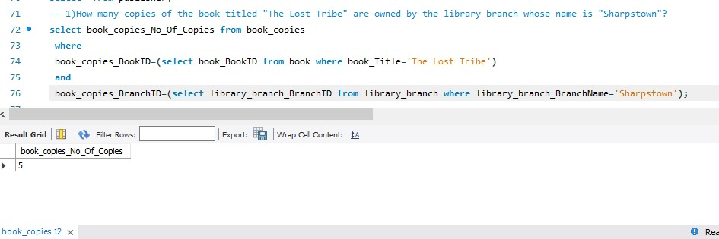
SQL Query Results
1. How many copies of the book titled "The Lost Tribe" are owned by the library branch whose name is "Sharpstown"?

Slide 9
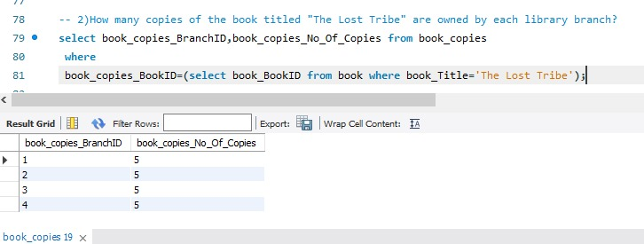
2. How many copies of the book titled "The Lost Tribe" are owned by each library branch?

Slide 10
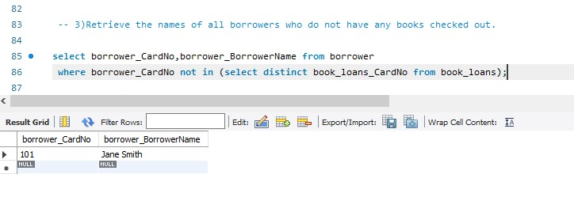
3. Retrieve the names of all borrowers who do not have any books checked out.

Slide 11
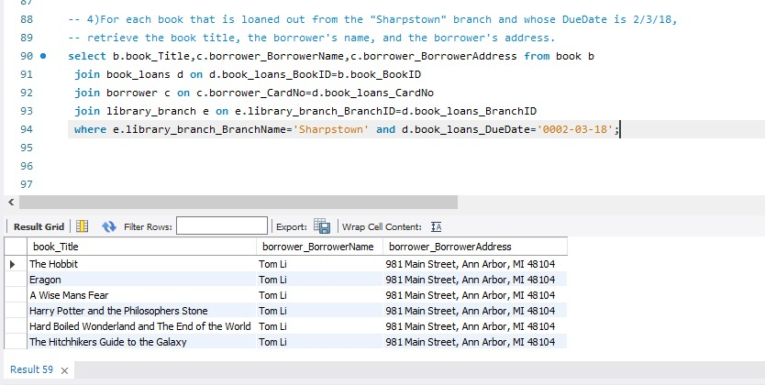
4. For each book that is loaned out from the "Sharpstown" branch and whose DueDate is 2/3/18, retrieve the book title, the borrower's name, and the borrower's address.

Slide 12
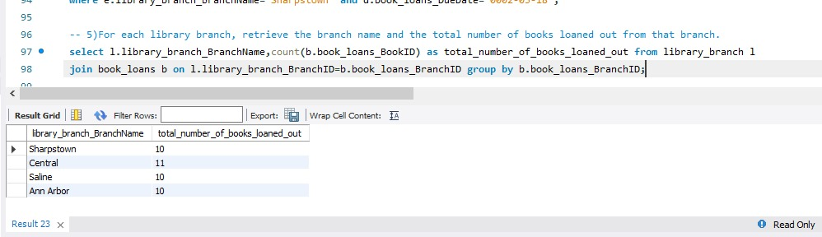
5. For each library branch, retrieve the branch name and the total number of books loaned out from that branch.

Slide 13
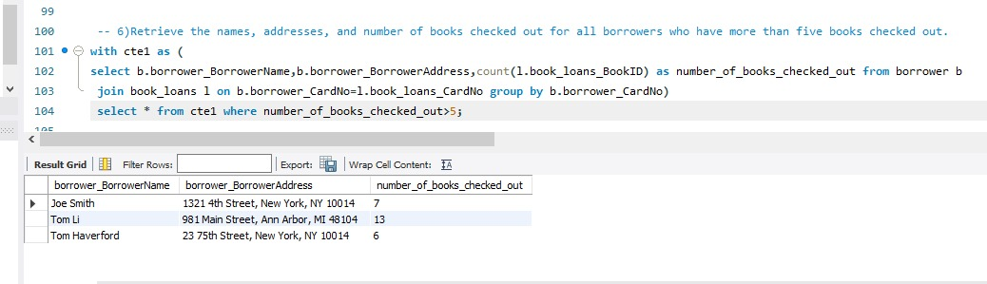
6. Retrieve the names, addresses, and number of books checked out for all borrowers who have more than five books checked out.

Slide 14
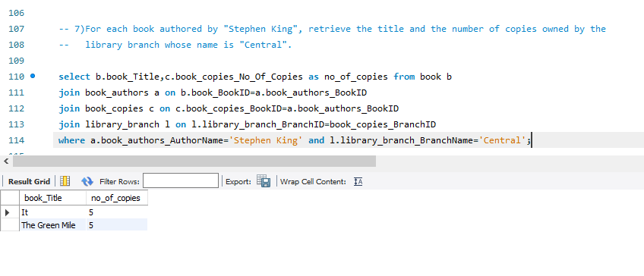
7. For each book authored by "Stephen King", retrieve the title and the number of copies owned by the library branch whose name is "Central".

Slide 15
Final Business Insights & Recommendations
Add online book reservation so members can book books from home.
Add automatic fine calculation when books are returned late.
Send reminders or messages to members about due dates.
Show reports of which books are most borrowed to help buy more copies.
Create a mobile app or website for easy access to library services.

Slide 16
Conclusion
The system helps the library keep records of books, authors, and publishers.
It makes it easy to know how many copies of a book are available in each branch.
It stores details of borrowers and tracks who has taken which book.
It helps the library manage issue dates and return dates properly.
It reduces manual work and saves time for library staff.
It makes library services faster and more helpful for members.

Slide 17
Experiences and Challenges
While importing CSV files, I made a mistake by not properly verifying the column names, which resulted in null values in the database.
➜ I resolved it by carefully checking and correcting the column names before re-importing the data.
I faced complexity while joining multiple tables for analysis queries.
➜ I overcame this challenge through continuous learning and practice of sql join concepts, which improved my understanding of relational databases.
Overall, this project helped me gain hands-on experience in creating databases, linking tables, and performing data analysis using SQL.

Slide 18

THANK YOU

